Slide 1
.NET Containerization with Kubernetes, Helm and Draft
South Florida Code Camp
2 March 2019

Slide 2
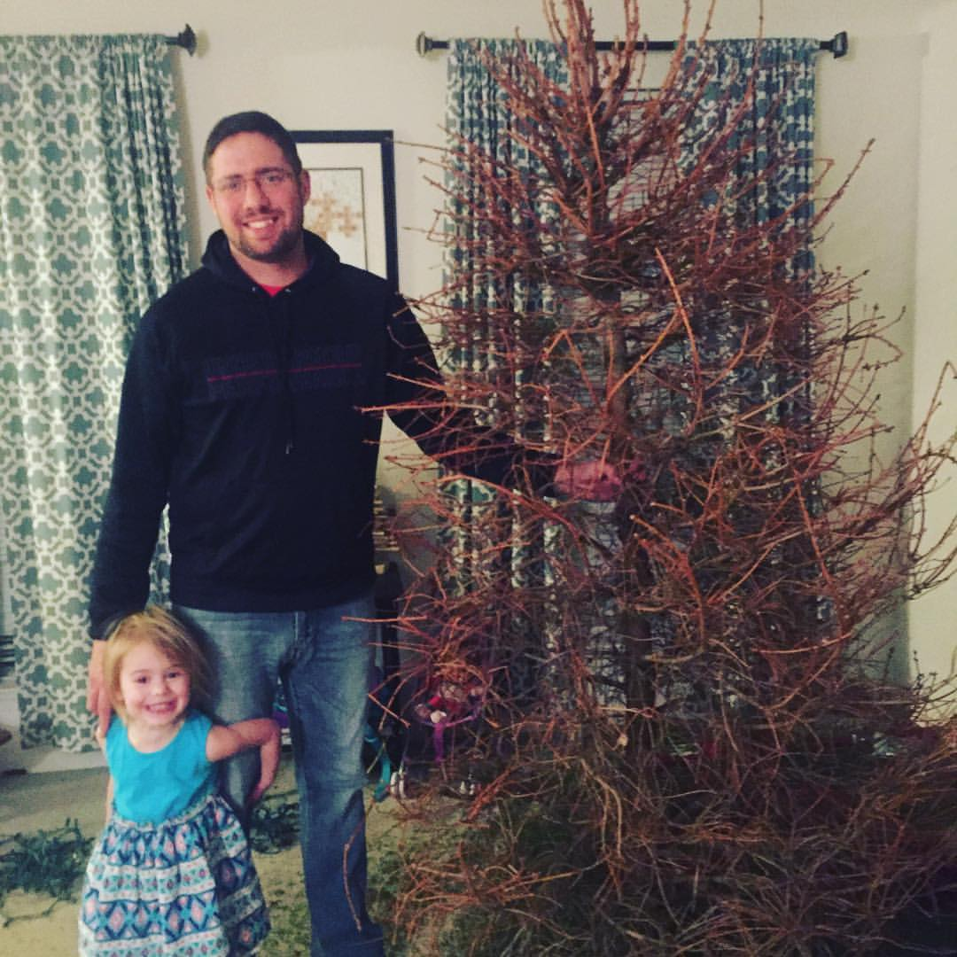
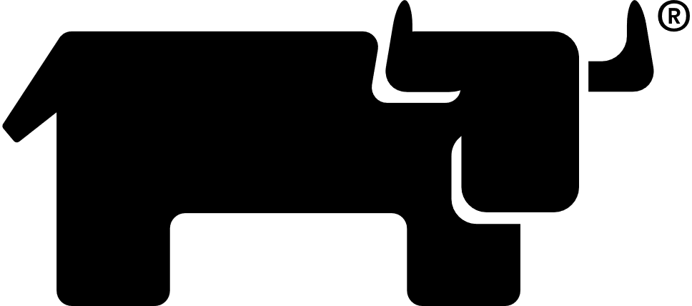
Jason L. van Brackel
Director of Community, Rancher Labs
@jasonvanbrackel - Twitter
@jvb - Slack
https://morehuman.software

Slide 3
Agenda
Docker
Kubernetes
Helm
Draft

Slide 4
More Information on Architecture
DockerCon 16: Windows Server & Docker - The Internals Behind Bringing Docker & Containers to Windows - Black Belt
https://channel9.msdn.com/Blogs/containers/DockerCon-16-Windows-Server-Docker-The-Internals-Behind-Bringing-Docker-Containers-to-Windows

Slide 5
Containers are not VMs
VMs
Containers
App A
App A₁
App B
Server Guest OS
Server Guest OS
Server Guest OS
App A
App A₁
App A₂
App A₃
App B
App B₁
Docker
Hypervisor (Type 1)
Server (Host OS)
Server
Server

Slide 6
Containers are not VMs
OS Virtualization
Userspace and Namespace Isolation
Enough of the OS for the Application to use
Docker Daemon responsible for maintaining isolation
Hardware Virtualization
OS Isolation
Full Copy of the OS
Hypervisor responsible for maintaining isolation
Containers
VMs

Slide 7
Containers Don’t Exist
They are an OS abstraction
A combination of
Cgroups
Namespaces
OS constructs

Slide 8
Container Types
OCI
Kata
Windows Server Containers
Hyper-V Containers (Default)

Slide 9
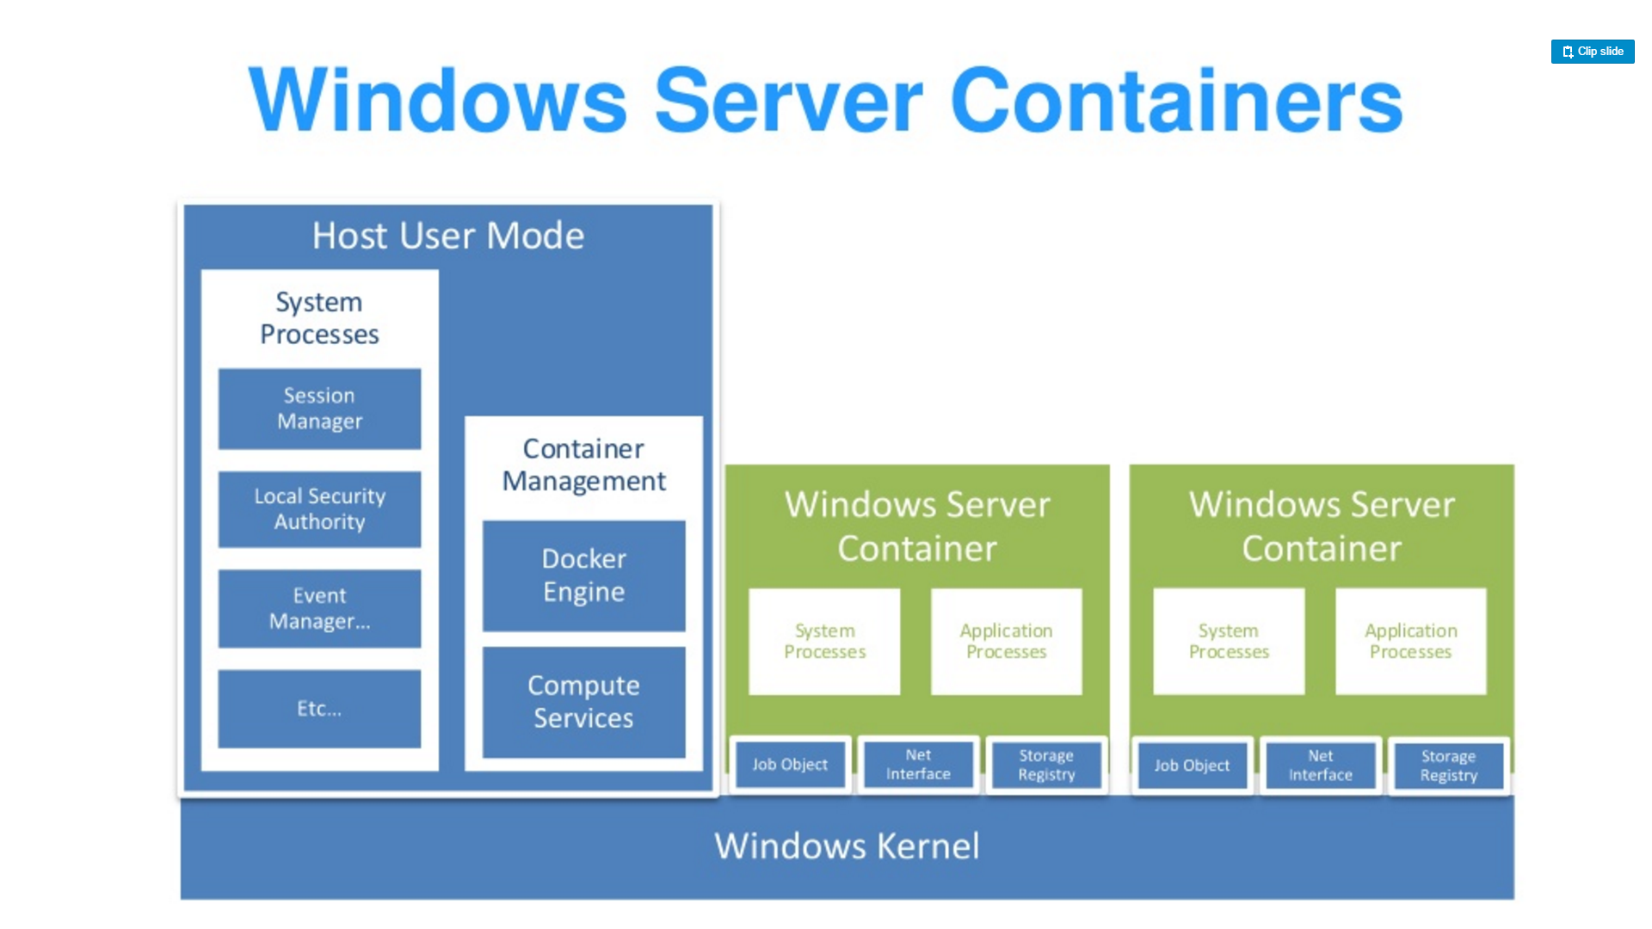
Source: “DockerCon 16: Windows Server & Docker - The Internals Behind Bringing Docker & Containers to Windows - Black Belt”

Slide 10
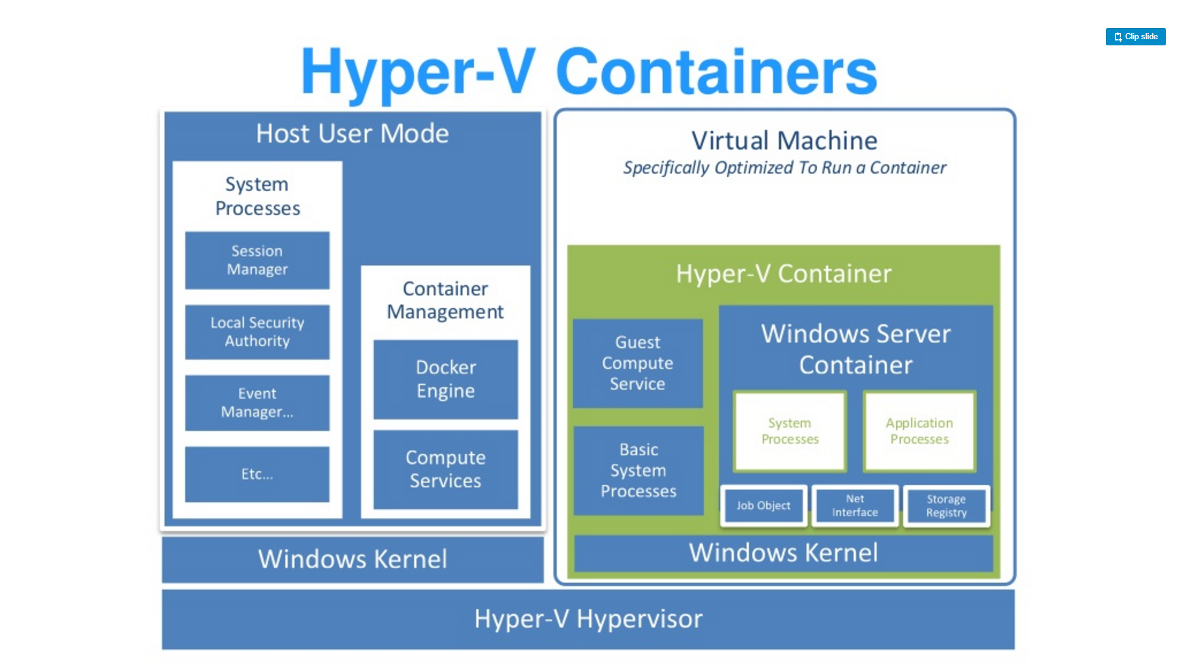
Source: “DockerCon 16: Windows Server & Docker - The Internals Behind Bringing Docker & Containers to Windows - Black Belt”

Slide 11
Getting Started With Docker
On Windows 10
https://docs.microsoft.com/en-us/virtualization/windowscontainers/quick-start/quick-start-windows-10
On Windows Server
https://docs.microsoft.com/en-us/virtualization/windowscontainers/quick-start/quick-start-windows-server

Slide 12
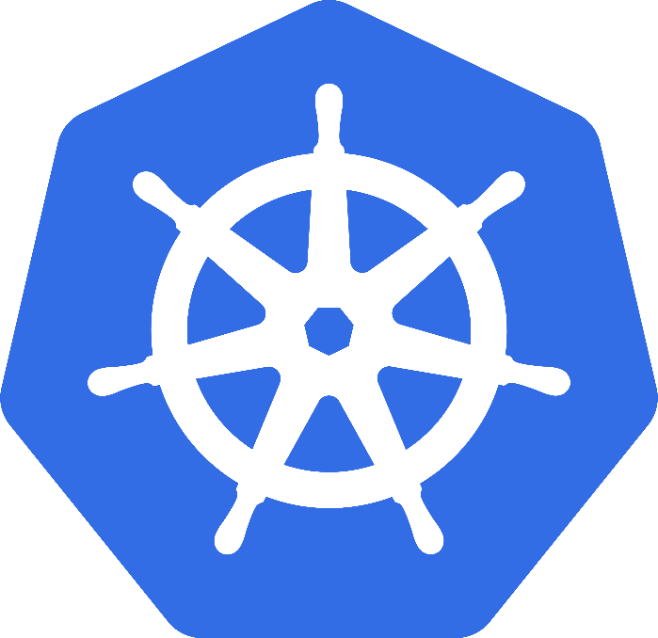
Kubernetes
Greek for “Helmsman”; also the root of the word “Governor”
Google’s 3rd Container Platform (Borg, Omega)
Set of compossable building blocks
Container orchestrator
Runs OCI Compliant Contaniers / Windows Containers
Supports multiple cloud and bare-metal environments
Built on lessons learned from Borg and Omega
Written in Go
Build to manage containerized applications, not machines
Kubernetes SIG-Windows
Notes:
Omega: Raw State Omega: Multiple Schedulers, Compossable building blocks

Slide 13
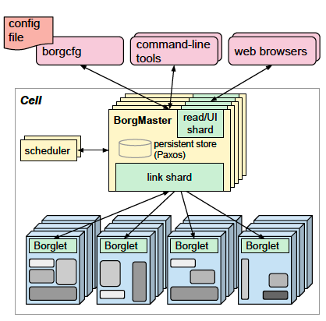
Kubernetes Lineage Google Borg
Runs hundreds of thousands of jobs..
..for many thousands of different applications (YouTube, Search Index, Maps, etc.)..
..across a number of clusters (hundreds)..
..each with up to tens of thousands of machines..
Borg currently manages many millions of physical servers hosting billions of containers!
In production since 2003!
Offers a declarative job specification language, name service integration, real-time job monitoring, and tools to analyze and simulate system behavior.
Source: Large-scale cluster management at Google with Borg

Slide 14
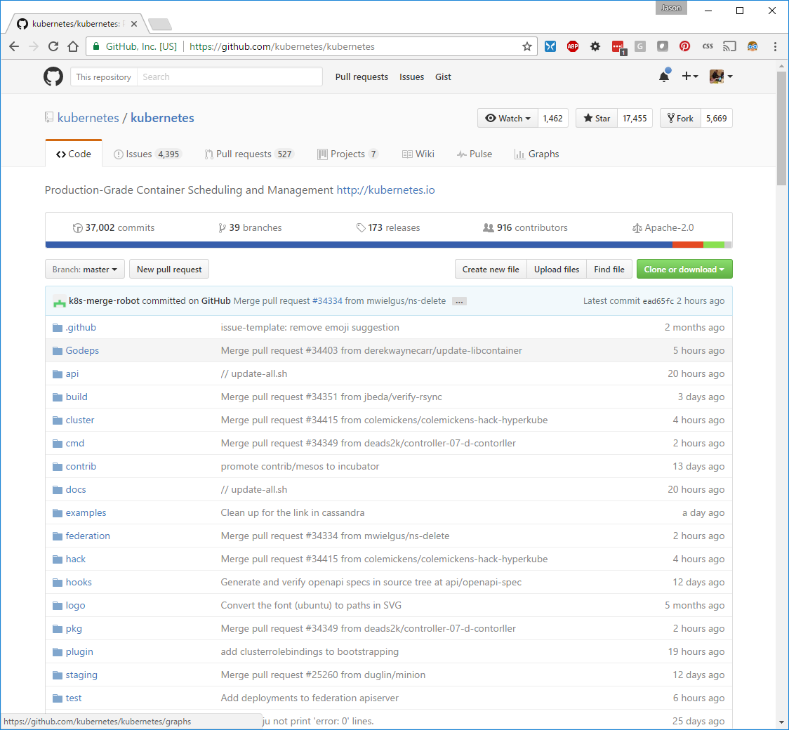

Slide 15
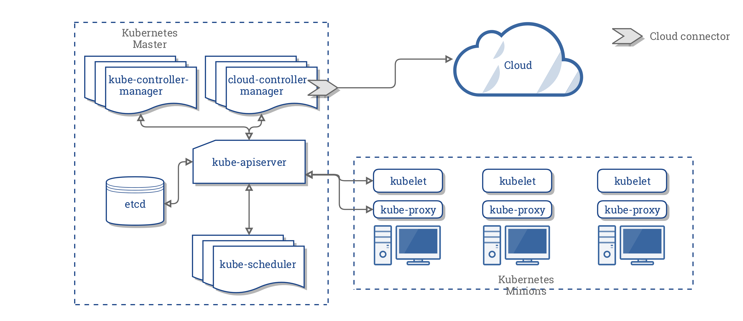
Kubernetes Architecture

Slide 16
Key Concepts
Container: An application package (Docker / Rocket)
Pod: A small group of tightly coupled Containers
Controller: A loop that drives current state towards desired state
Service: A set of running pods that work together
Ingress: Path Based Routing
Labels: Identifying metadata attached to other objects
Selector: A query against labels, producing a set result
Secret: Hide stuff

Slide 17
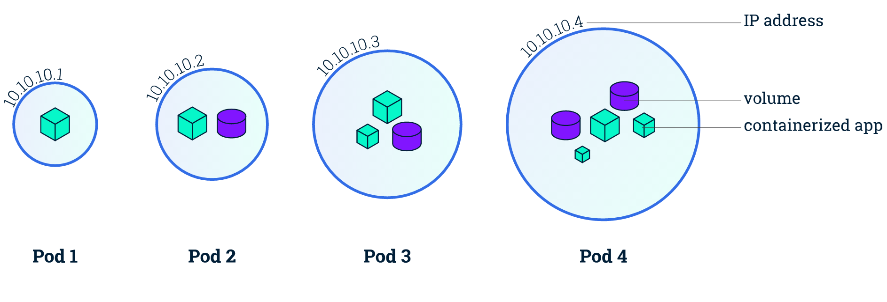
Containers & Pods
Small group of containers & volumes
Tightly coupled
Always on the same node
Atomic unit of cluster scheduling & placement
Shared namespace, IP and localhost
Ephemeral

Slide 18
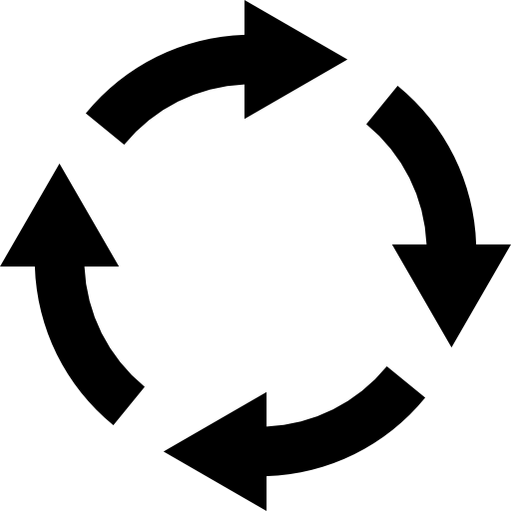
Controller
Control Loops
Replica Sets
Deployments
Stateful Sets
Daemon Sets

Slide 19
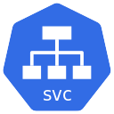
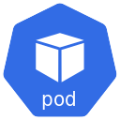
Services
Virtual IP to Expose Pods
ClusterIP
NodePort
Layer 4 Load Balancer
External Name
HostPort

Slide 20
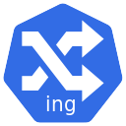
Ingress
Http host and path based routing
Implemented by an Ingress Controller

Slide 21
Labels and Selectors
app=myapp
Key/Value Pairs on API Objects
app=myapp
app=myapp
app=myapp
Version=v1
Version=v1
Version=v2

Slide 22
ConfigMaps & Secrets
Configuration Data
Secrets are not encrypted, base64 encoded
ConfigMaps are PlainText

Slide 23

What is Helm?
Helm helps you manage Kuberentes-based applications via charts
Features
Install
Upgrade
Rollback
Delete

Slide 24
What is Helm?
Helm uses Tiller to manange Kubernetes application via Charts
Charts include
Kubernetes API Definiton templates for the application
Configurable Values
Chart metadata for publishing
https://helm.sh

Slide 25

What is Draft?
Draft extends Helm to help you bootstrap configuration for Kubernetes based applications.
Features
Create
Upgrade
Connect

Slide 26
What is Draft?
Draft uses Packs to author charts based on code scanning heuristics.
Draft supports
Java
Node
DotNet (Core)
Go
And more

Slide 27
Demo Time
https://morehuman.software
https://github.com/JasonvanBrackel/dotnet-containerization-with-k8s-helm-draft

Slide 28
Demo Time!

